Slide 1



GDP³

Slide 2
Project
Enhancing GDP Nowcasting with Machine Learning
Problem: Traditional econometric nowcasting methods suffer from overfitting and miss complex real-time relationships
Challenges: Managing missing data, limited historical records, and high-dimensional features while maintaining interpretability
Approach: Advanced data engineering with automated feature generation, robust selection algorithms, and optimised ML models for more reliable forecasts
Notes:
Mixed frequency data, many econometric models have the same frequency

Slide 3
Why does it matter
Ministers rely on GDP forecasts to make critical decisions on tax and spending, directly impacting the national budget
Accurate GDP forecasts help determine how much the government can borrow and spend while maintaining fiscal sustainability
Early warning of weak growth enables preventive policy action before recessions impact jobs and living standards (e.g., investment programs, tax adjustments, or regulatory changes)

Slide 4
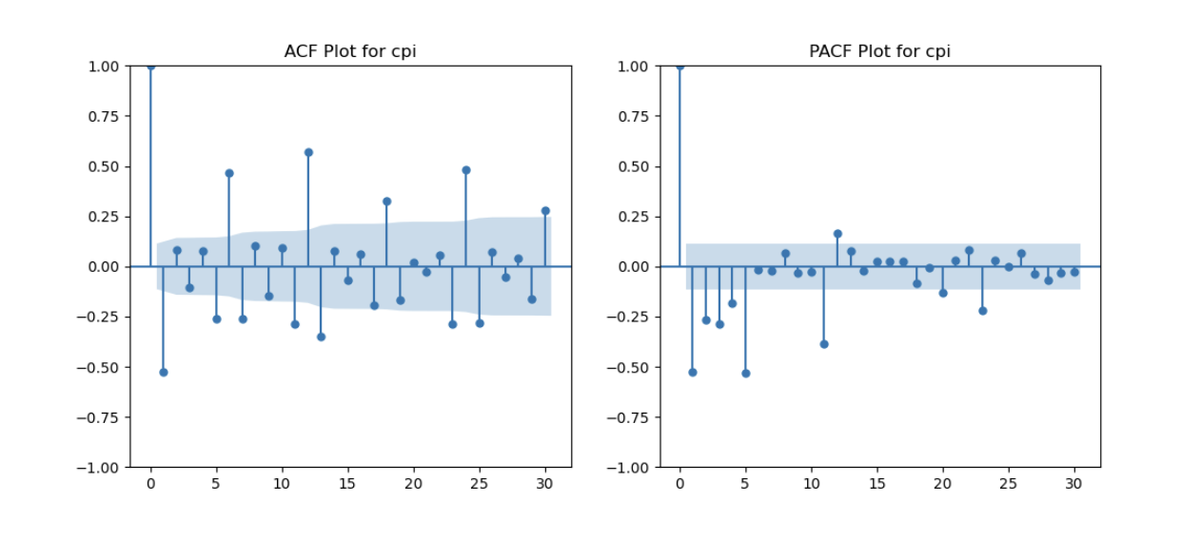
Feature Engineering
Data Quality Issues
A brute force approach was suboptimal
Optimise column selection with tested time series analysis

Slide 5

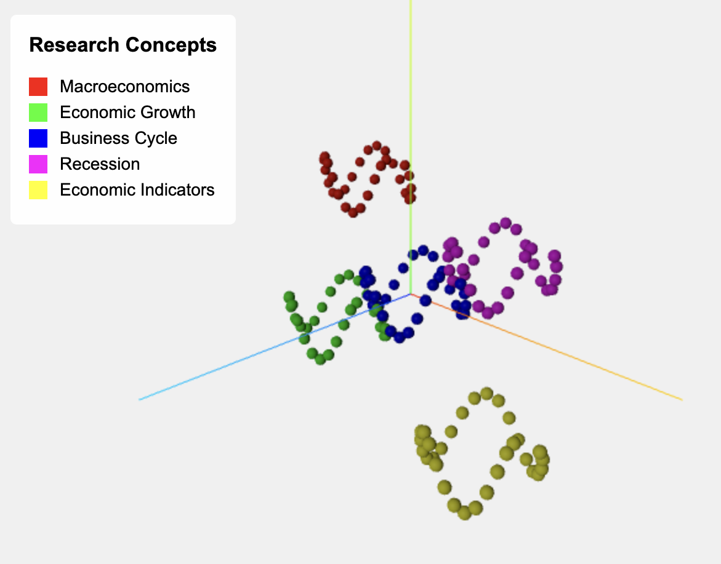
Novel feature: Text Data
Research Question: Can text data predict economic trends?
Our Approach:
Collected 100,000+ economics research papers from OpenAlex (1998-2024)
Focused on key concepts: Macroeconomics, Economic Growth, Business Cycles, etc.
Converted paper abstracts into numeric features using text embeddings
Key Finding: Academic literature shows measurable predictive power for GDP movements, suggesting research content may serve as a leading economic indicator.
Simple but powerful idea: The topics in text data may reflect or even anticipate economic conditions.

Slide 6
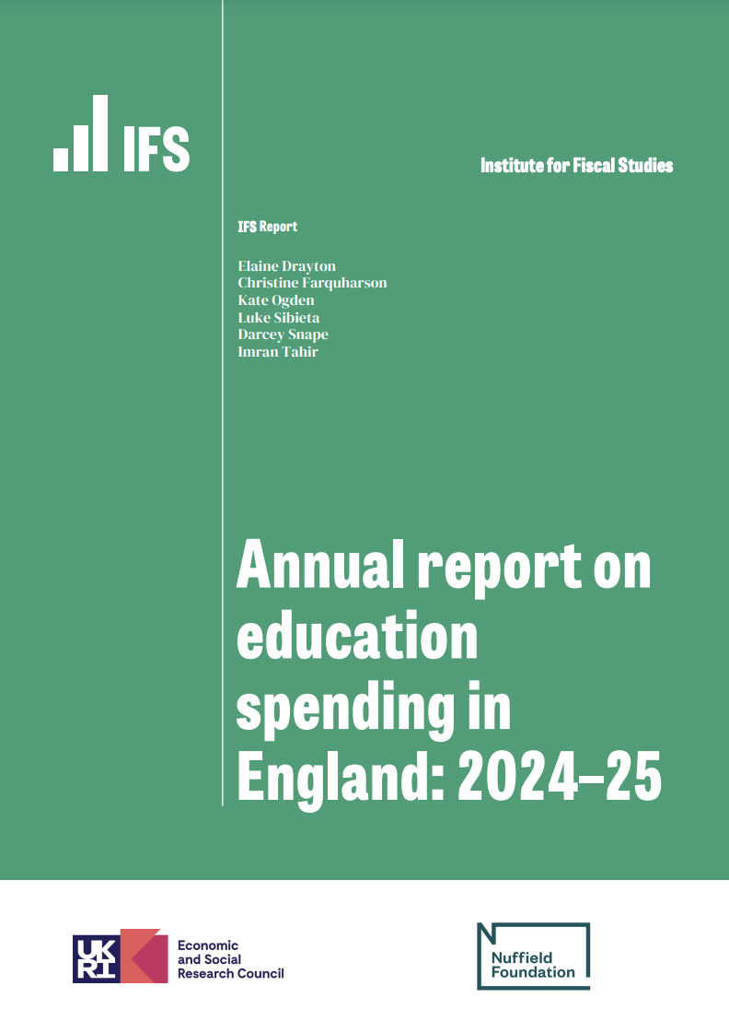
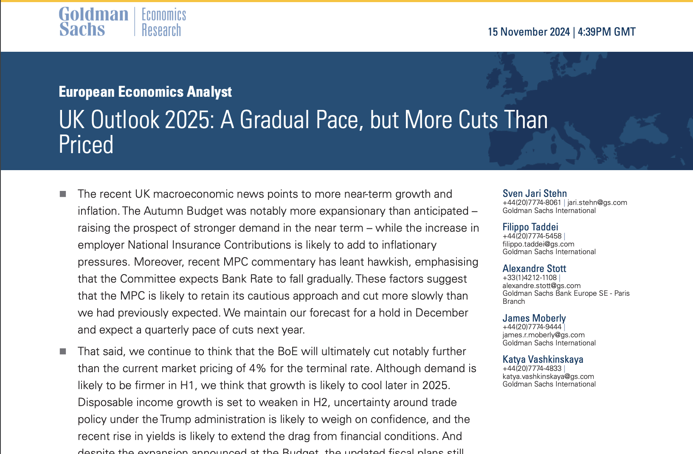
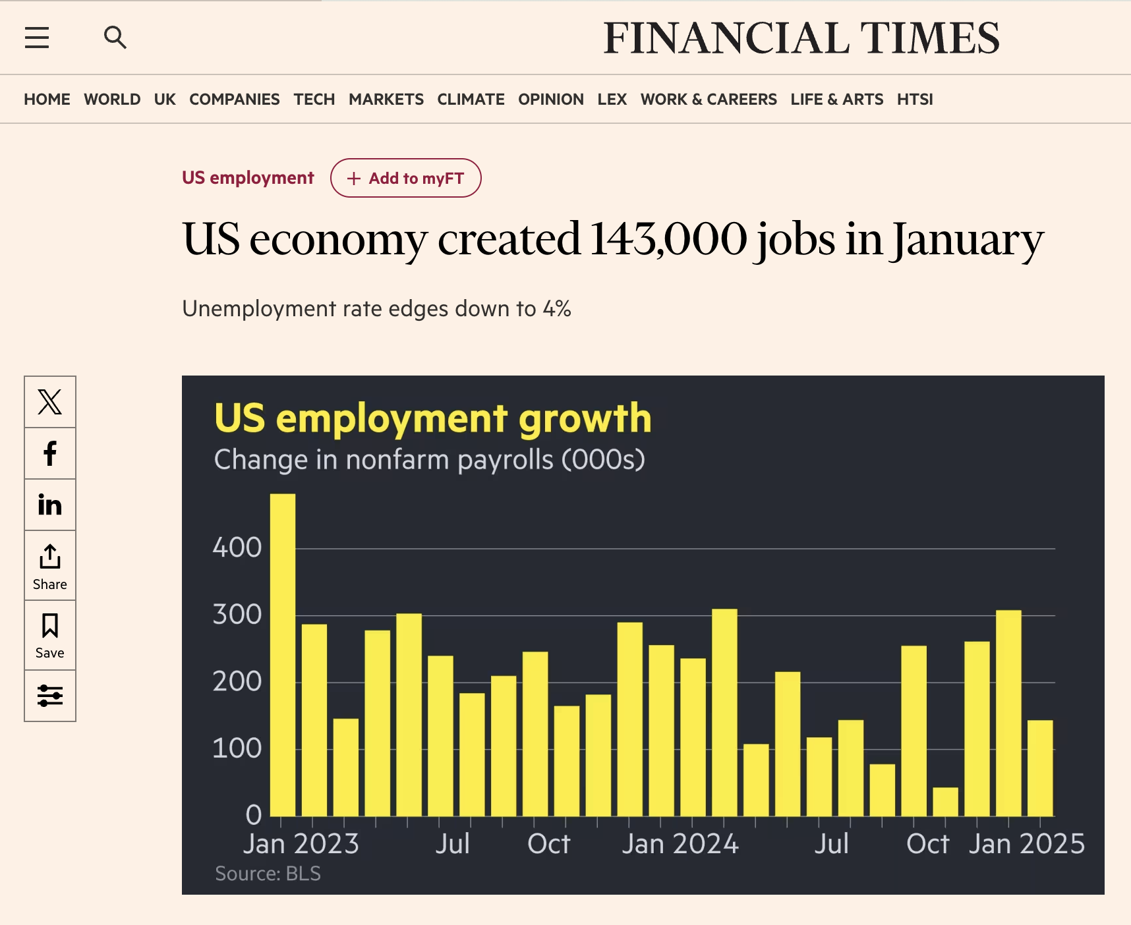


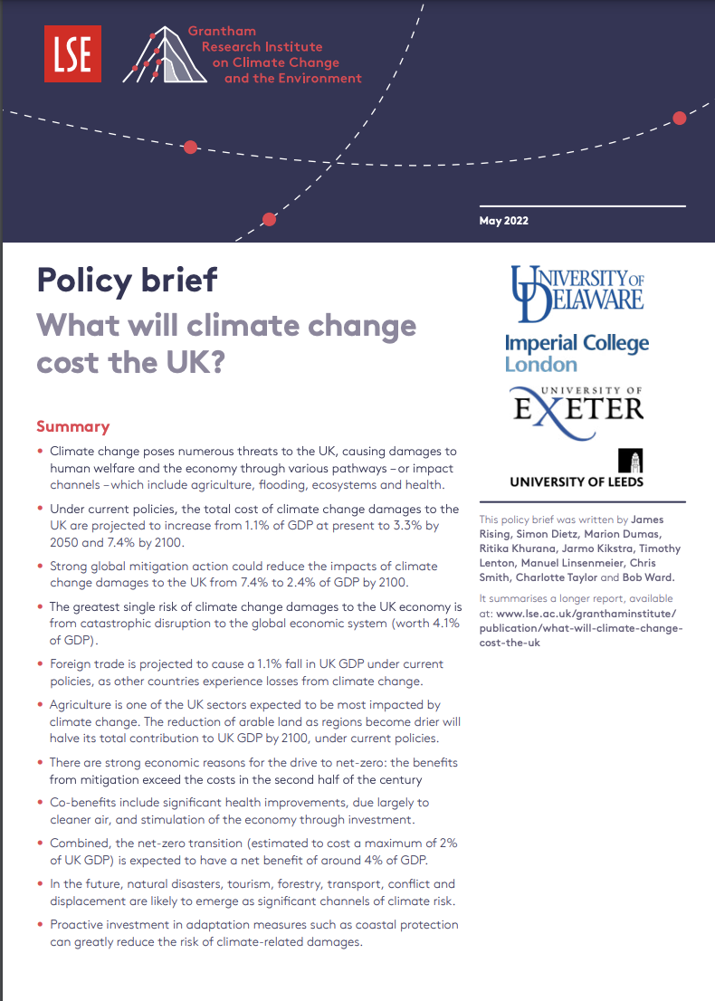
Novel feature: Text Data

Slide 7
Feature Selection
Blends Two Techniques to Avoid Overfitting: Elastic Net uses a combination approach to make sure the model is reliable and not overly complex
Handles Related Factors Well: It manages interconnected data points better, ensuring that all relevant information is considered, unlike other methods that might overlook some related details
Uses machine learning to identify variables with the most effect
Notes:
131 starting variables -> 70 selected variables

Slide 8
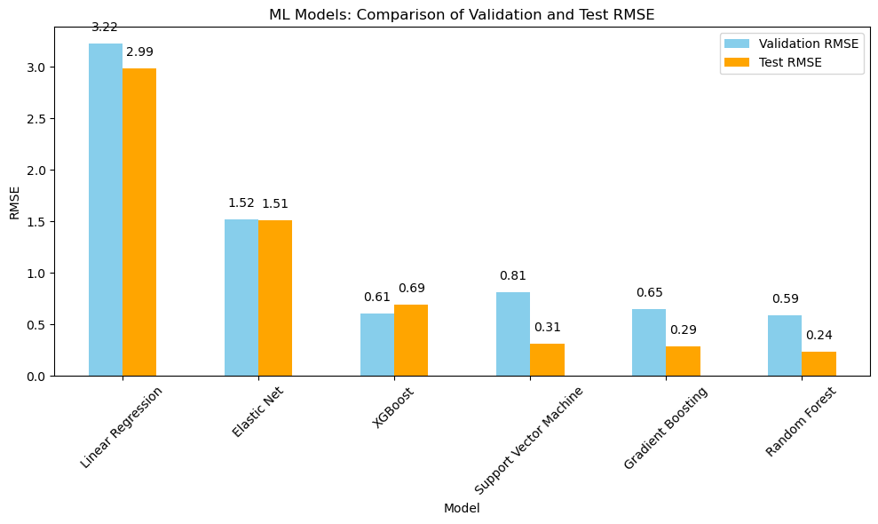
Models

Slide 9
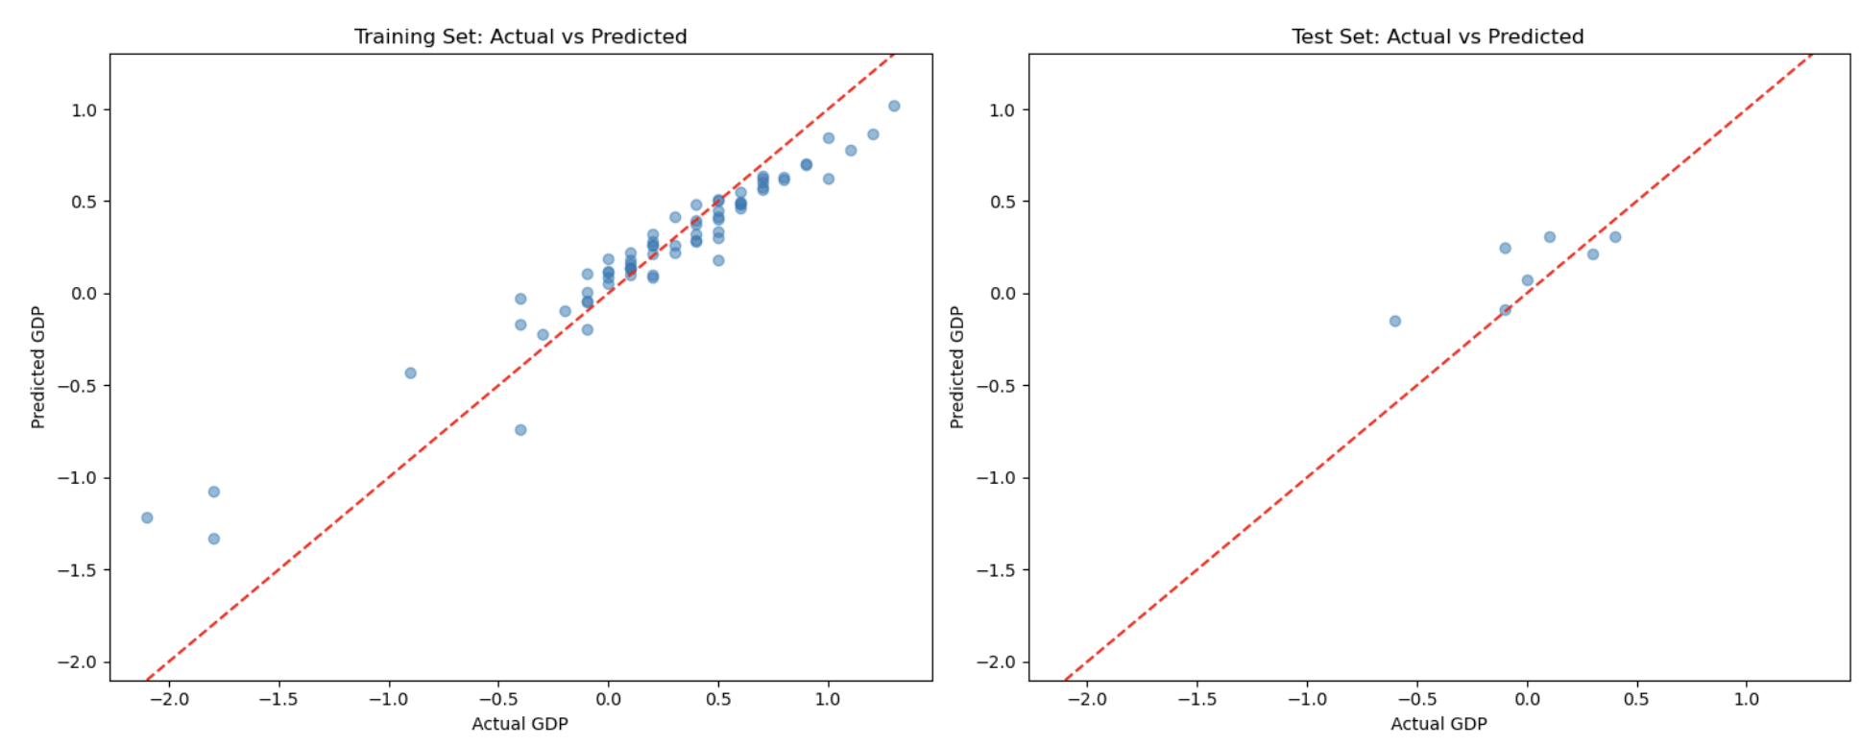
Best model performance (RMSE 0.24, MAE 0.18)

Slide 10
Summary
Forecasts have improved the accuracy for nowcasting UK GDP by 40%
Dynamic machine learning framework rapidly evaluates new economic signals to enhance predictions
Daily forecasts powered by real-time text analysis capture the latest market shifts and sentiment

Slide 11
Annex

Slide 12
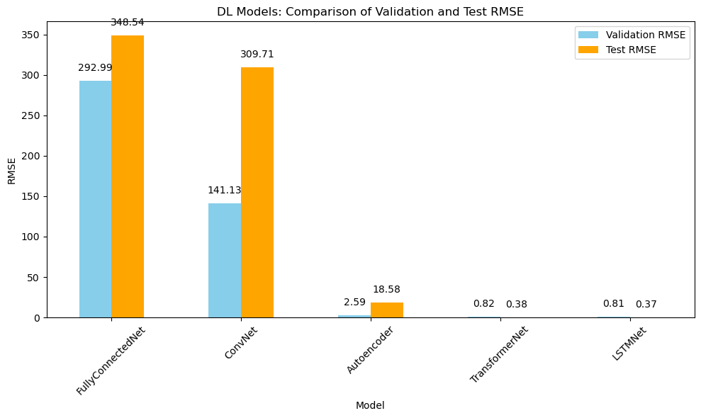
Deep learning

Slide 13
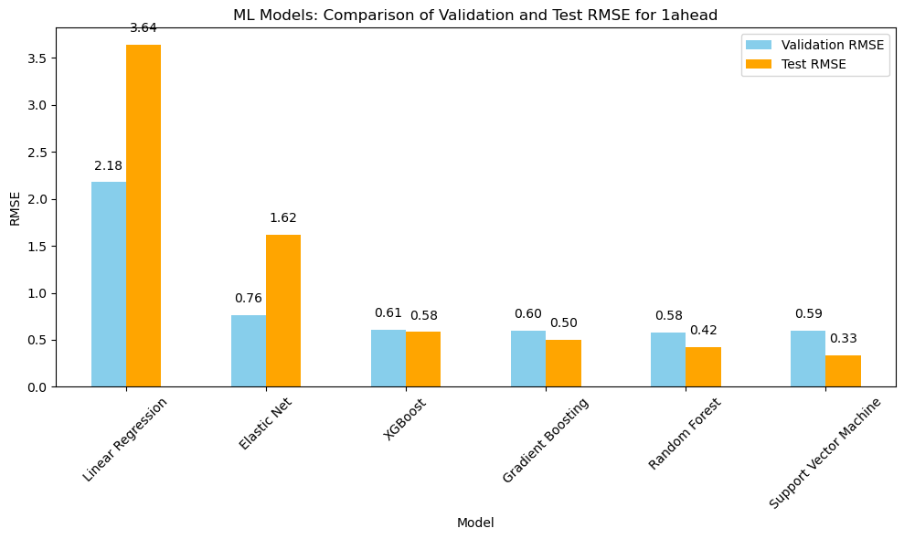

Slide 14
